Slide 1
Wind Energy Conversion Systems

Slide 2
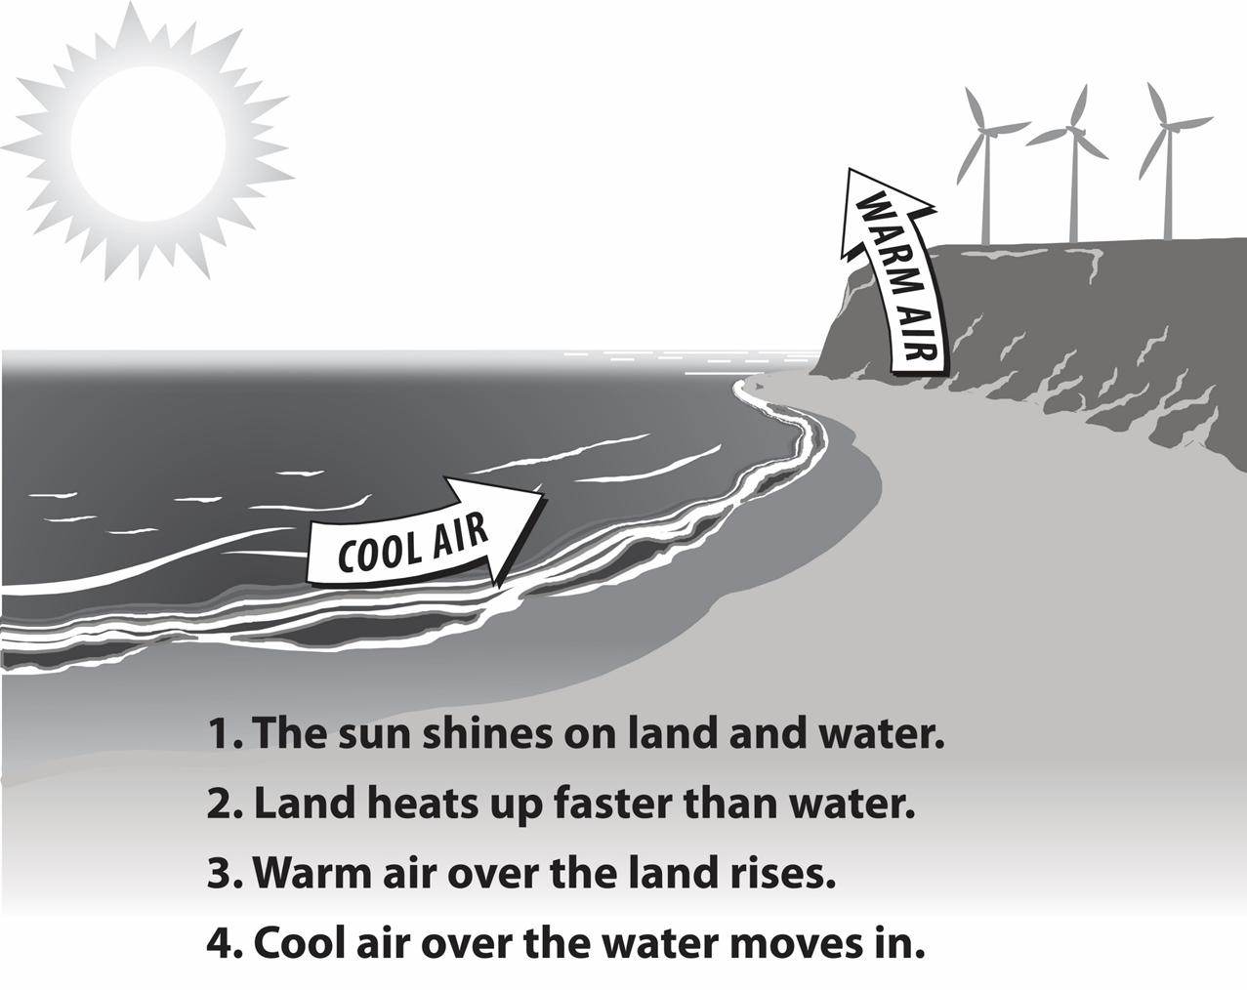
What Makes Wind
Heat from the sun causes convection in the atmosphere, meaning the heated air rises. These currents create zones of high and low air pressure within the atmosphere. As the heated air rises, it creates a low pressure zone near the ground. Air from surrounding cooler areas rushes in to balance the pressure. These horizontal pressure differences account for the ambient wind and more intense storm wind.

Slide 3
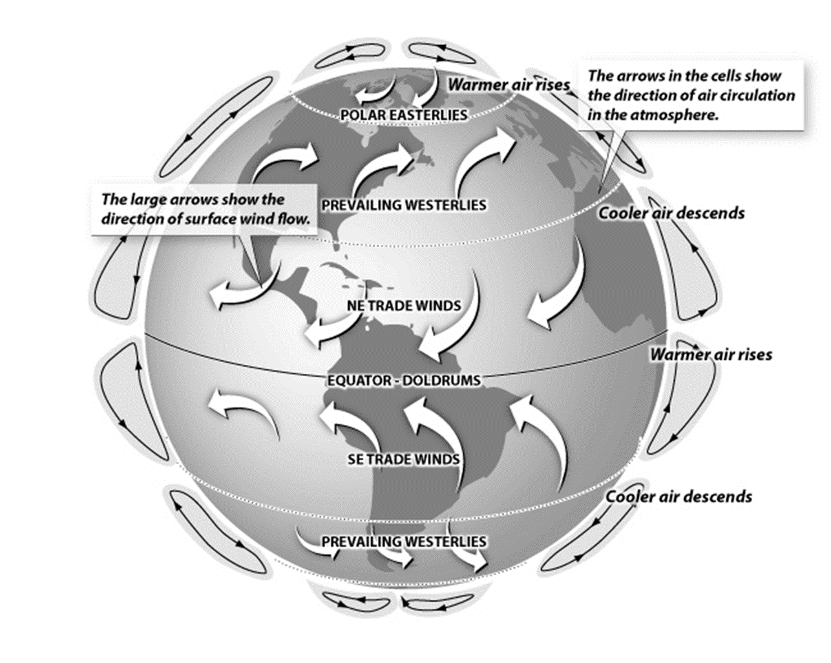
Global Wind Patterns
Prevailing winds are caused by the temperature differences between the Earth’s poles and its equatorial regions, as well as Earth’s rotation. The Earth’s atmosphere has several very large and steady prevailing patterns, such as the polar easterlies and the northeast trade winds. Winds are named based on the direction they originate from.
In North America, one of the prevailing dominant wind paths track in an arc from the prairies to the Great Lakes and the eastern seaboard – this wind travels in a westerly direction.
Wind energy is also affected by other factors. Air currents move faster and more consistently at higher altitudes–think of the blustery conditions at the tops of tall buildings or on mountain tops. Similarly, wind tends to gather energy when it moves unimpeded over longer distances, which is why very flat regions, such as the prairies, tend to be highly exposed to intense winds.

Slide 4
History of Wind Energy
5000 BC
Sailboats used on the Nile indicate the power of wind
500-900 AD
First windmills developed in Persia
1300 AD
First horizontal-axis
windmills in Europe
1850s
Daniel Halladay and
John Burnham build
Halladay Windmill; start US Wind Engine Company
Late 1880s
Thomas O. Perry
conducted 5,000
wind experiments;
starts Aermotor Company
1888
Charles F. Brush
used windmill to generate electricity
in Cleveland, OH
Early 1900s
Windmills in CA
pumped saltwater
to evaporate ponds
1941
In VT, Grandpa’s
Knob turbine
supplies power to
town during WWII
1979
First wind turbine
rated over 1 MW
began operating
1985
CA wind capacity
exceeded 1,000 MW
1993
US Wind Power developed
first commercial variable-speed wind turbine
2004
Electricity from
wind generation
costs 3 to 4.5 cents per kWh
2013
Wind power provided
over 17% of renewable
energy used in US
2016
Block Island Offshore Wind Farm was brought online (US’s first offshore wind farm)
Notes:
5000 BC - The history of wind energy is certainly long, beginning thousands of years ago. It is estimated that as early as 5000 B.C. sail boats were in use on the Nile as boatmen realized the power of the wind.
500-900 AD - The first windmills were developed in Persia for pumping water and grinding grain.
About 1300 - The first horizontal-axis windmills appeared in Western Europe.
1850s - Daniel Halladay and John Burnham worked to build and sell the Halladay Windmill, which was designed for the American West. It had an open tower design and thin wooden blades. They also started the U.S. Wind Engine Company.
Late 1880s - Thomas O. Perry conducted over 5,000 wind experiments trying to build a better windmill. He invented the mathematical windmill, which used gears to reduce the rotational speed of the blades. This design had greater lifting power, smoother pumping action, and could operate in lighter winds. Perry started the Aermotor Company with LaVerne Noyes.
The development of steel blades made windmills more efficient. Six million windmills sprang up across America as settlers moved west. Homesteaders purchased windmills from catalogs, traveling salesman, or they built their own. Mills were used to pump water, shell corn, saw wood, and mill grain.
1888 - Charles F. Brush used the first large windmill to generate electricity in Cleveland, Ohio. Windmills that produce electricity started to be called "wind turbines." In later years, General Electric acquired Brush's company, Brush Electric Co.
1893 - In Chicago, Illinois, the World's Columbian Exposition (aka the Chicago World Fair) highlighted 15 windmill companies who showcased their goods.
Early 1900s - Windmills in California pumped saltwater to evaporate ponds to produce salt for consumption.
1941 - On a hilltop in Rutland, Vermont, "Grandpa's Knob" wind turbine supplied power to the local community for several months during World War II. It had 53-meter blades and was the Smith-Putnam wind turbine.
1979 - The first wind turbine rated over 1 megawatt began operating. The cost of electricity from wind generation was about 40 cents per kilowatt-hour.
1985 - Many wind turbines were installed in California in the early 1980s to help meet growing electricity needs and take advantage of government incentives. By 1985, California wind capacity exceeded 1,000 megawatts, enough power to supply 250,000 homes. These wind turbines were inefficient compared to today’s turbines.
1993 - U.S. WindPower developed one of the first commercially available variable-speed wind turbines, the 33M-VS. The final prototype tests were completed in 1992. The $20 million project was funded mostly by U.S. Windpower, but also involved Electric Power Research Institute (EPRI), Pacific Gas & Electric, and Niagara Mohawk Power Company.
2004 - Electricity from wind generation cost 3 - 4.5 cents per kilowatt-hour.
2011 - Wind power provided 12.8 percent of the renewable energy consumed in the U.S. In the U.S., wind power produced enough electricity on average to power the equivalent of over 10 million homes.

Slide 5
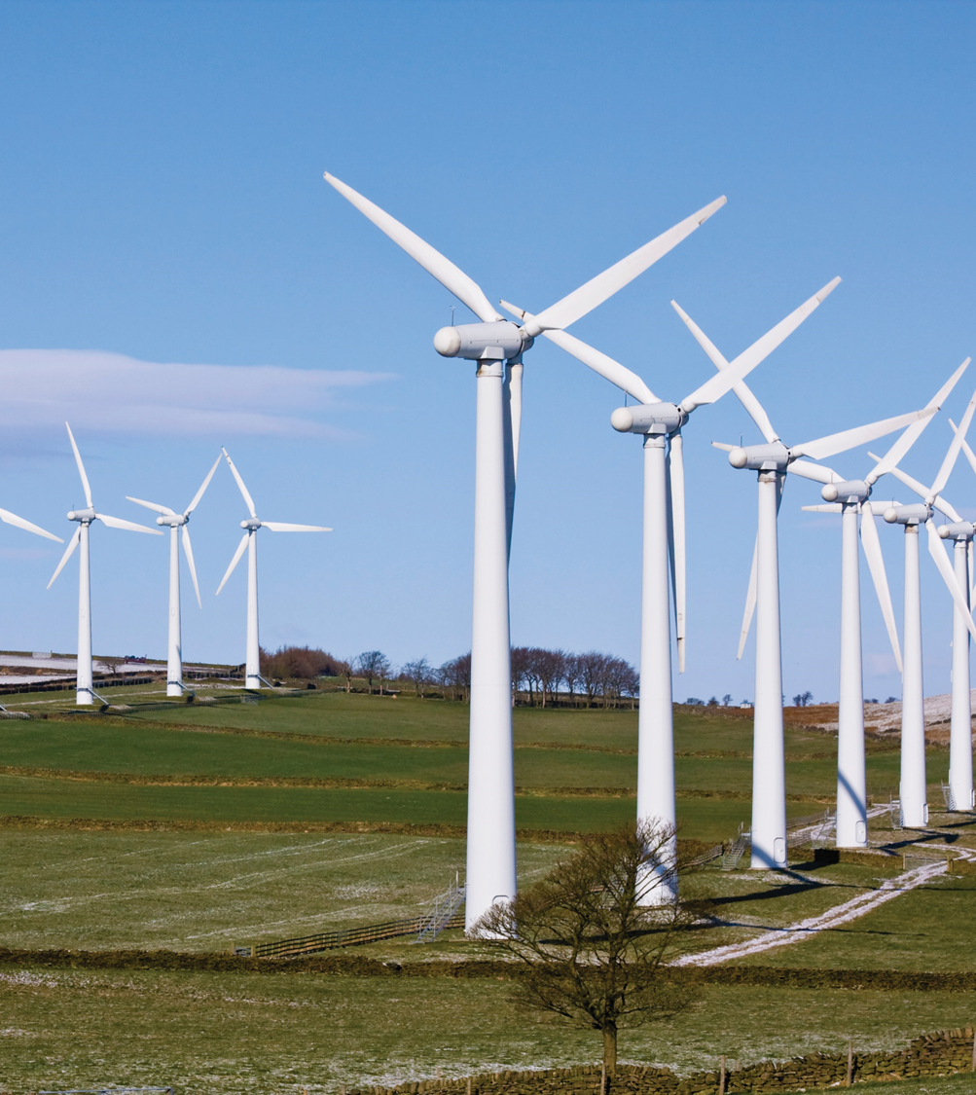
Why Wind Energy?
Clean, zero emissions
NOx, SO2, CO, CO2
Air quality, water quality
Climate change
Reduce fossil fuel dependence
Energy independence
Domestic energy—national security
Renewable
No fuel-price volatility

Slide 6
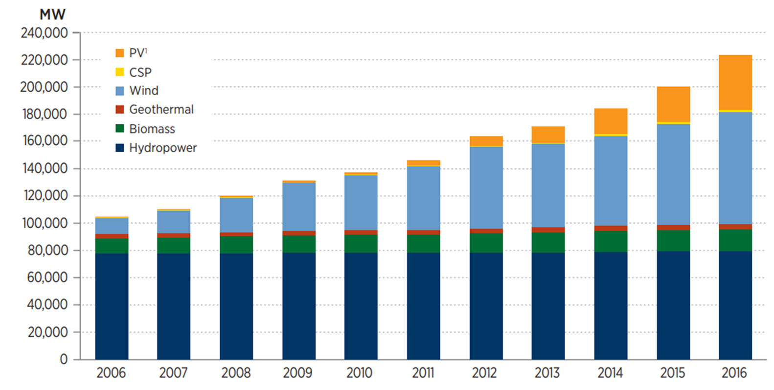
Renewable Electric Capacity Worldwide
Wind energy is one of the fastest growing energy resources in the world.
U.S. wind electricity capacity grew 8.2 GW in 2016

Slide 7
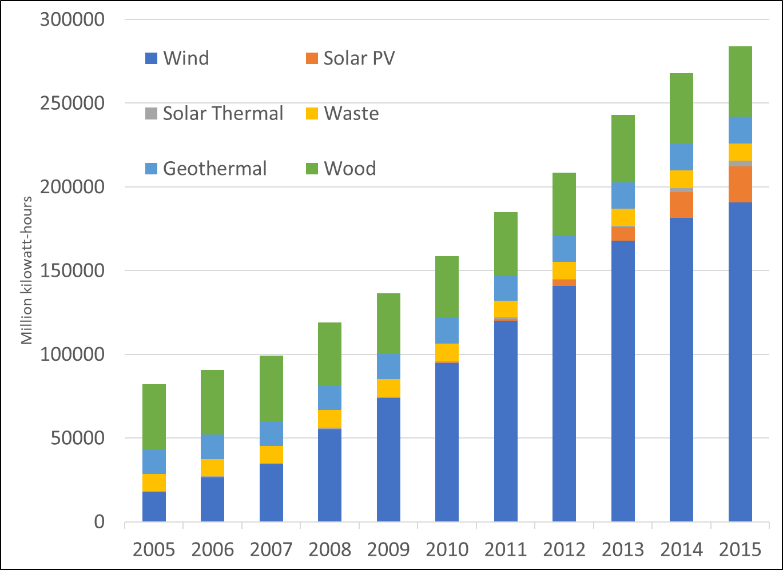
U.S. Electricity Generation from Non-Hydro Renewables
In the past several years wind has shown tremendous growth as a source for electricity among renewables in the United states.

Slide 8
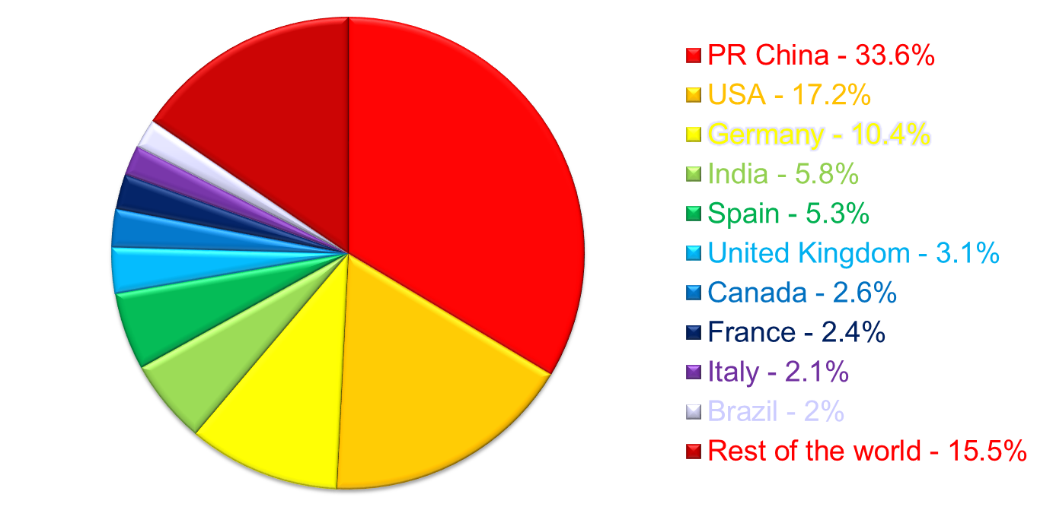
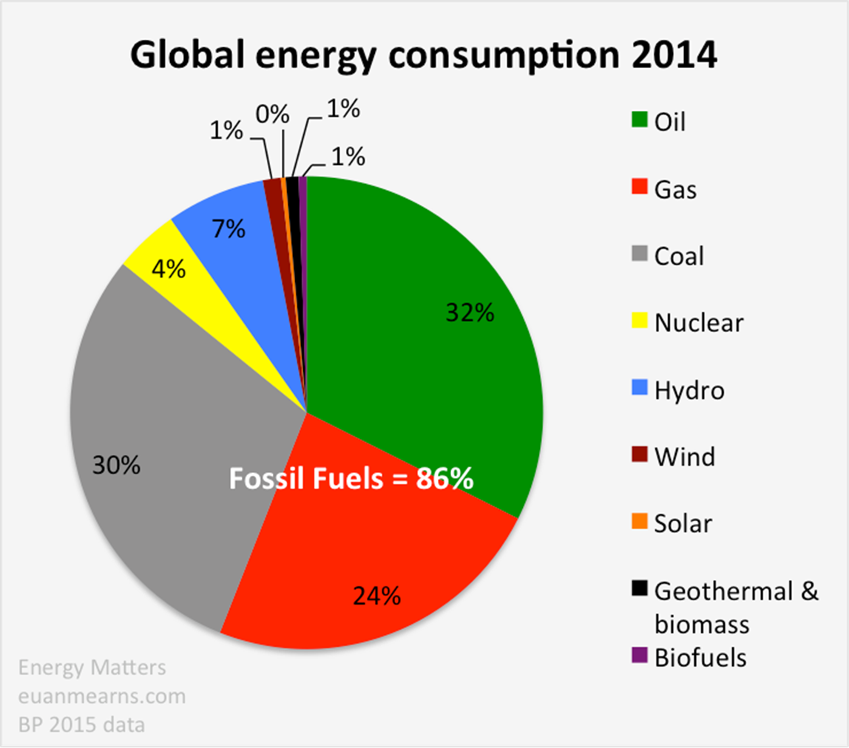
WORLD WIND POWER CAPACITY

Slide 9
Sun-Sentinel, August 26, 2007
2008 – 2018 Green Energy Era
WT boom times all over the world Europe, US, India, China, Australia, New Zealand
In the US, unprecedented federal and state government support to further WT development (tax credit, research funding, development grants and loans to industries)
Emergence of WT- technician training programs through community colleges.
By end of 2015, U.S. had 74,471 MW installed power, which is 4% of U.S. total. [Could be 20% by 2030, 25% by 2035, 30% by 2050.]
Denmark is now 41.1% wind, 50% by 2020
In a recent report, the DOE said the nation’s wind-power capacity increased by 27 percent in 2006, and that the United States had the fastest-growing wind-power capacity in the world in 2005 and 2006.
Still, despite wind farms now operating in 36 states, wind accounts for less than 1 percent of the U.S. power supply.
[Now up to 3.8%.]

Slide 10
December 14, 2009 (Wall Street Journal)
DOE Outpaces Venture in Cleantech Investments
The federal government through DOE, has taken a large role in the shaping of the clean energy sector. DOE plans to either lend or grant more than $ 40 billion to companies working on clean technology and, to that end, in the first nine months of 2009, the agency has allocated $ 13 billion to business developing everything from electric vehicle and the batteries that power them, to wind turbines and solar panels. In comparison, venture capital firms have invested $ 2.68 million in clean energy technology in the same period of time.

Slide 11
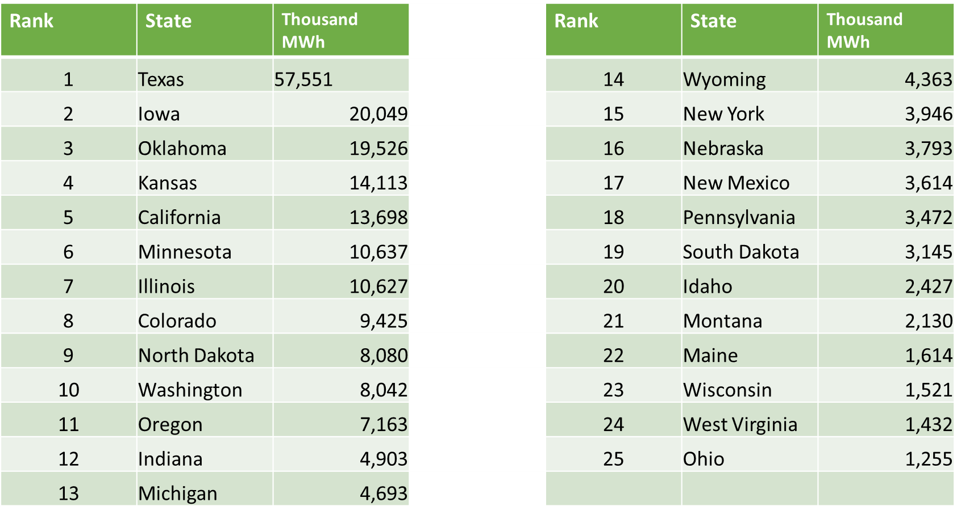
Top Wind Power Producing States, 2016
Texas leads the country in installed wind capacity with around 25% of current capacity.

Slide 12
Wind Energy Regions in India
India has several on shore and off shore wind energy sites.
India has a lot of scope in terms of harnessing wind power using these sites.
The state wise estimated wind power potential in India is shown in table1 (Gross potential is based on assuming 1% of land availability for wind power generation in potential areas.)
Sr. No | State | Gross potential (MW) | Total capacity (31/09/2004) | Technical Potential(MW)
1 | Andhra Pradesh | 8275 | 101.3 | 1750
2 | Gujarat | 9675 | 218.5 | 1780
3 | Karnataka | 6620 | 274.2 | 1120
4 | Madhya Pradesh | 5500 | 26.35 | 825
5 | Maharashtra | 3650 | 411.15 | 3020
6 | Tamilnadu | 3050 | 1683.6 | 1750
7 | Rajasthan | 5400 | 212.0 | 895
8 | West Bengal | 450 | 1.1 | 450
9 | Kerala | 875 | 2 | 605
10 | Others 2990 3.1 - | 2990 | 3.1 | --
11 | Total (All India) | 45195 | 2884.75 | 12875

Slide 13
Wind Energy Regions in India
WEG of 2 MW capacity is installed in suzlon (Tamilnadu) is the largest power rating in India.
Max WEG installations are in Tamilnadu of capacity about 1639MW.
Maximum gross estimated Wind potential is in Gujarat of 9675 MW.

Slide 14
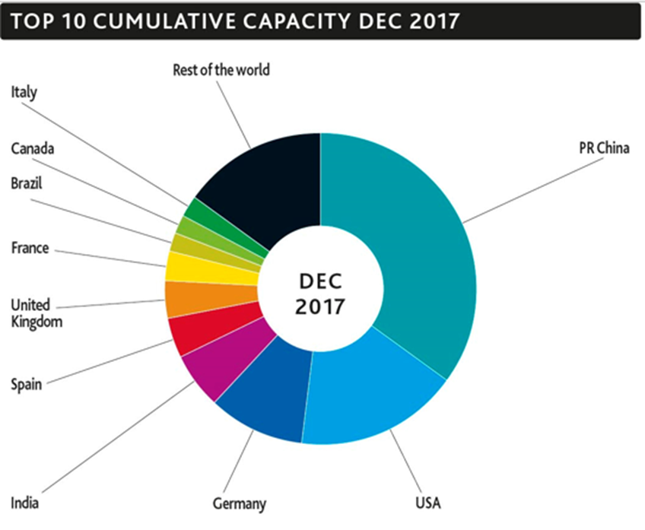
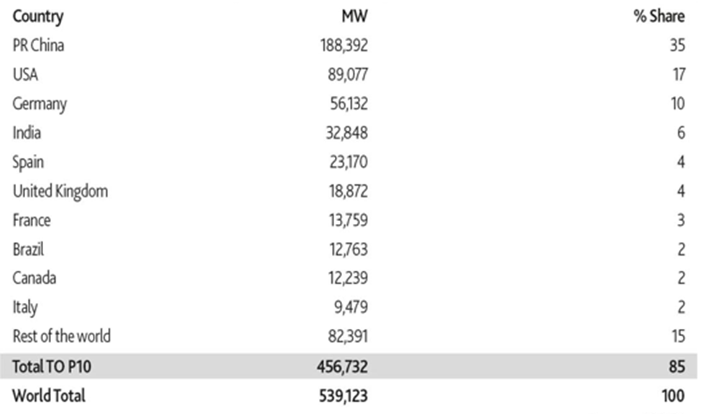
China Leads the World in Wind Capacity
China has more than double the wind generating capacity than any other country

Slide 15
Classification of wind mill
1. Based on orientation of the axis of rotor
(a) Horizontal axis (b) Vertical axis
A horizontal axis machine has its blades rotating on an axis parallel to the ground.
A vertical axis machine has its blades rotating on an axis perpendicular to the ground
Very few vertical axis machines are available commercially
2. Based on type of rotor
(a) Propeller type (Horizontal axis)
1. Single 2. Two blade 3. Three blade
(b) Multiple blade type (Horizontal axis)
1. multi bladed 2. Bicycle type multi bladed
Most commonly wind mill are propeller type with 2-3 blade for economical reason.
Three blade designs are preferable since its rotor is naturally balanced. Generation of power capacity of 15 kW up to higher capacity of 3 MW.
WT are made of aerofoil section. Rotational speeds of propeller type are 300-400 rpm while speeds of multi blade type (12-20) wind mill are 60-80 rpm.
Materials used mostly FRP. Diameter of rotors used 2-5 meter
(c) Savonius type (Vertical axis)
(d) Darrieus type (Vertical axis)

Slide 16
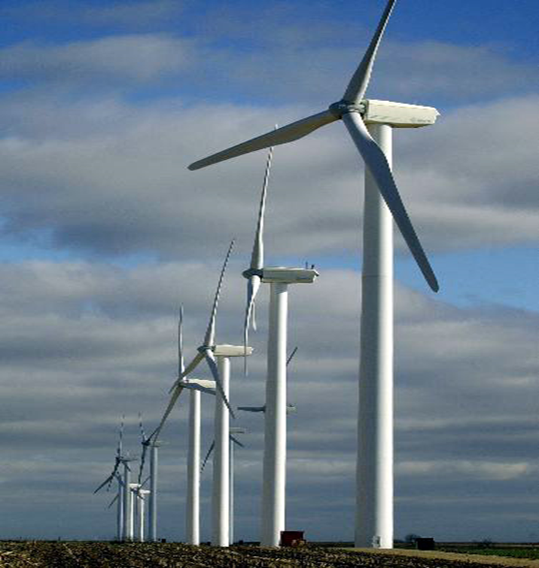
HAWT:
This is the most common wind turbine design.
In addition to being parallel to the ground, the axis of blade rotation is parallel to the wind flow.
Some machines are designed to operate in an upwind mode, with the blades upwind of the tower.
In this case, a tail vane is usually used to keep the blades facing into the wind.
Other designs operate in a downwind mode so that the wind passes the tower before striking the blades.
Some very large wind turbines use a motor-driven mechanism that turns the machine in response to a wind direction sensor mounted on the tower.
In this case, a tail vane is usually used to keep the blades facing into the wind.
Other designs operate in a downwind mode so that the wind passes the tower before striking the blades.
Some very large wind turbines use a motor-driven mechanism that turns the machine in response to a wind direction sensor mounted on the tower.
Commonly found horizontal axis wind mills are aero-turbine mill with 35% efficiency and farm mills with 15% efficiency.

Slide 17
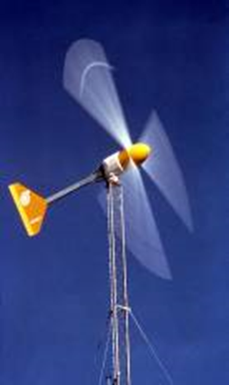
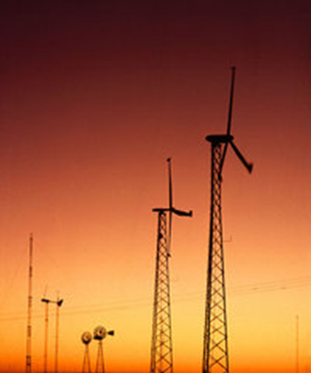
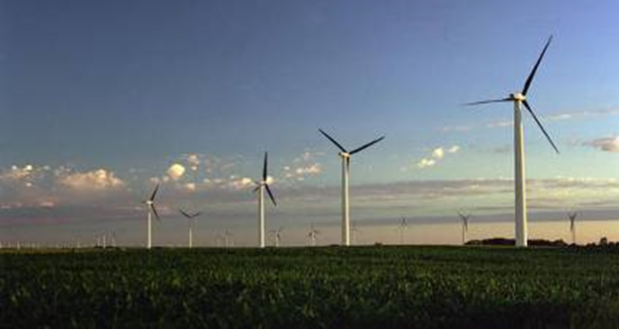
Small (<10 kW)
Homes
Farms
Remote Applications (e.g., water pumping, Telecom sites, ice making)
Intermediate (10-250 kW)
Village Power
Hybrid Systems
Distributed Power
Large (250 kW-2+ MW)
Central Station Wind Farms
Distributed Power
Schools

Slide 18
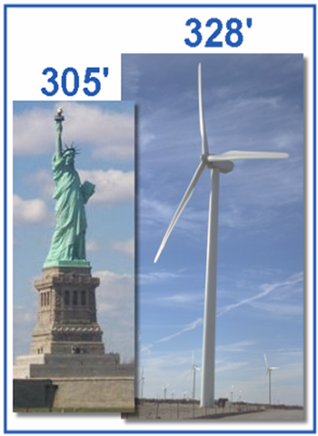
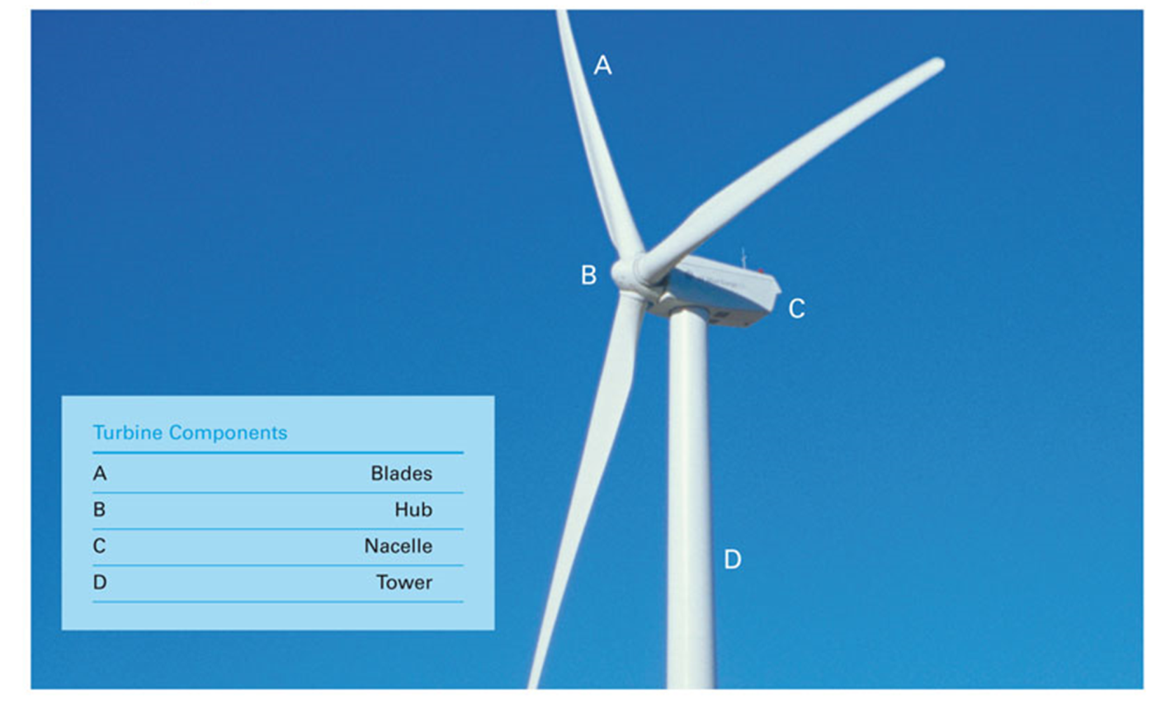
Large Wind Turbines
Common Utility-Scale Turbines
328’ base to blade
Each blade is 112’
200 tons total
Foundation 20’ deep
Rated at 1.5-2 megawatts
Supply power to about 500 homes

Slide 19
VAWT
Although vertical axis wind turbines have existed for centuries, they are not as common as their horizontal counterparts.
The main reason for this is that they do not take advantage of the higher wind speeds at higher elevations above the ground as well as horizontal axis turbines.
The basic vertical axis designs are the Darrieus, which has curved blades and efficiency of 35%, the Giromill, which has straight blades, and efficiency of 35%, and the Savonius, which uses scoops to catch the wind and the efficiency of 30%.
A vertical axis machine need not be oriented with respect to wind direction.
Because the shaft is vertical, the transmission and generator can be mounted at ground level allowing easier servicing and a lighter weight, lower cost tower.
Although vertical axis wind turbines have these advantages, their designs are not as efficient at collecting energy from thewind as are the horizontal machine designs.
There is one more type of wind-mill called Cyclo-gyro wind-mill with very high efficiency of about 60%. However, it is not very stable and is very sensitive to wind direction. It is also very complex to build.

Slide 20
Advantages
Disadvantages
Omni-directional
accepts wind from any direction
Components can be mounted at ground level
ease of service
lighter weight towers
Can theoretically use less materials to capture the same amount of wind
Rotors generally near ground where wind is poorer
Centrifugal force stresses blades
Poor self-starting capabilities
Requires support at top of turbine rotor
Requires entire rotor to be removed to replace bearings
Overall poor performance and reliability

Slide 21
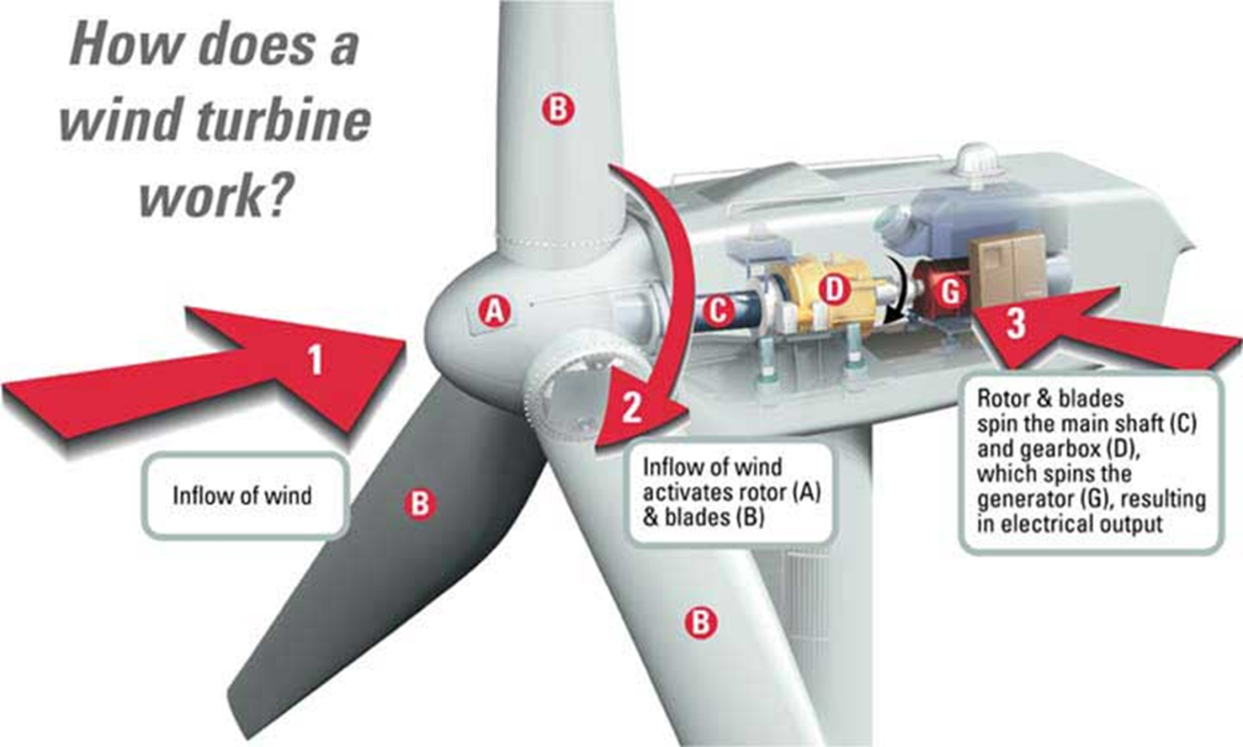
Main Components of a wind-mill
Rotor:
The portion of the wind turbine that collects energy from the wind is called the rotor.
The rotor usually consists of two or more wooden, fiberglass or metal blades which rotate about an axis (horizontal or vertical)at a rate determined by the wind speed and the shape of the blades.
The blades are attached to the hub, which in turn is attached to the main shaft
Drag Design:
Blade designs operate on either the principle of drag or lift.
For the drag design, the wind literally pushes the blades out of the way.
Drag powered wind turbines are characterized by slower rotational speeds and high torque capabilities.

Slide 22
Lift Design:
The lift blade design employs the same principle that enables airplanes, kites and birds to fly.
The blade is essentially an airfoil, or wing.
When air flows past the blade, a wind speed and pressure differential is created between the upper and lower blade surfaces.
The pressure at the lower surface is greater and thus acts to "lift" the blade.
When blades are attached to a central axis, like a wind turbine rotor, the lift is translated into rotational motion.
Lift-powered wind turbines have much higher rotational speeds than drag types and therefore well suited for electricity generation.
Tip Speed Ratio:
The tip-speed is the ratio of the rotational speed of the blade to the wind speed.
The larger this ratio, the faster the rotation of the wind turbine rotor at a given wind speed.

Slide 23
Electricity generation requires high rotational speeds.
Lift-type wind turbines have maximum tip-speed ratios of around 10, while drag-type ratios are approximately 1.
Given the high rotational speed requirements of electrical generators, it is clear that the lift-type wind turbine is most practical for this application.
The number of blades that make up a rotor and the total area they cover affect wind turbine performance.
For a lift-type rotor to function effectively, the wind must flow smoothly over the blades.
To avoid turbulence, spacing between blades should be great enough so that one blade will not encounter the disturbed, weaker air flow caused by the blade which passed before it.
It is because of this requirement that most wind turbines have only two or three blades on their rotors.

Slide 24
Generator:
The generator is what converts the turning motion of a wind turbine's blades into electricity.
Inside this component, coils of wire are rotated in a magnetic field to produce electricity.
Different generator designs produce either alternating current (AC) or direct current (DC), and they are available in a large range of output power ratings.
The generator's rating, or size, is dependent on the length of the wind turbine's blades because more energy is captured by longer blades.
It is important to select the right type of generator to match intended use.
Most home and office appliances operate on 240 volt, 50 cycles AC.
Some appliances can operate on either AC or DC, such as light bulbs and resistance heaters, and many others can be adapted to run on DC.
Storage systems using batteries store DC and usually are configured at voltages of between 12 volts and 120 volts.
Generators that produce AC are generally equipped with features to produce the correct voltage of 240 V and constant frequency 50 cycles of electricity, even when the wind speed is fluctuating.
DC generators are normally used in battery charging applications and for operating DC appliances and machinery.
They also can be used to produce AC electricity with the use of an inverter, which converts DC to AC.

Slide 25
Transmission:
The number of rpm of a wind turbine rotor can range between 40 rpm and 400 rpm, depending on the model and the wind speed.
Generators typically require rpm's of 1,200 to 1,800.
As a result, most wind turbines require a gear-box transmission to increase the rotation of the generator to the speeds necessary for efficient electricity production.
Some DC-type wind turbines do not use transmissions.
Instead, they have a direct link between the rotor and generator.
These are known as direct drive systems.
Without a transmission, wind turbine complexity and maintenance requirements are reduced.
But a much larger generator is required to deliver the same power output as the AC-type wind turbines.

Slide 26
Tower:
The tower on which a wind turbine is mounted is not just a support structure.
It also raises the wind turbine so that its blades safely clear the ground and so it can reach the stronger winds at higher elevations.
Maximum tower height is optional in most cases, except where zoning restrictions apply.
The decision of what height tower to use will be based on the cost of taller towers versus the value of the increase in energy production resulting from their use.
Studies have shown that the added cost of increasing tower height is often justified by the added power generated from the stronger winds.
Larger wind turbines are usually mounted on towers ranging from 40 to 70 meters tall.

Slide 27
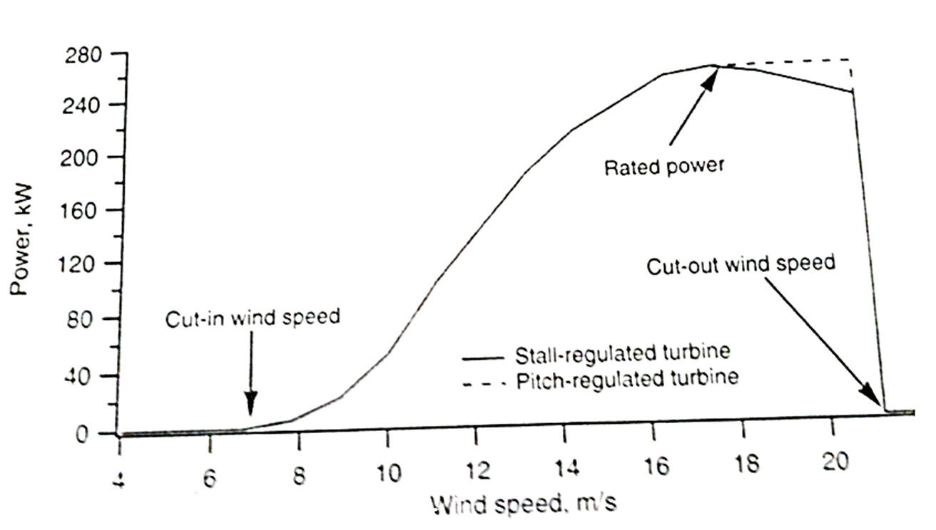
Operating Characteristics of wind mills
Cut-in Speed:
Cut-in speed is the minimum wind speed at which the blades will turn and generate usable power.
This wind speed is typically between 10 and 16 kmph.
Rated Speed:
The rated speed is the minimum wind speed at which the wind turbine will generate its designated rated power.
For example, a "10 kilowatt" wind turbine may not generate 10 kilowatts until wind speeds reach 40 kmph.
Rated speed for most machines is in the range of 40 to 55 kmph.
At wind speeds between cut-in and rated, the power output from a wind turbine increases as the wind increases.
The output of most machines levels off above the rated speed. Most manufacturers provide graphs, called "power curves," showing how their wind turbine output varies with wind speed.

Slide 28
Cut-out Speed:
At very high wind speeds, typically between 72 and 128 kmph, most wind turbines cease power generation and shut down.
The wind speed at which shut down occurs is called the cut-out speed.
Having a cut-out speed is a safety feature which protects the wind turbine from damage.
Shut down may occur in one of several ways. In some machines an automatic brake is activated by a wind speed sensor.
Some machines twist or "pitch" the blades to spill the wind.
Still others use "spoilers," drag flaps mounted on the blades orthe hub which are automatically activated by high rotor rpm's, or mechanically activated by a spring loaded device which turns the machine sideways to the wind stream.
Normal wind turbine operation usually resumes when the wind drops back to a safe level.

Slide 29
Betz Limit:
It is the flow of air over the blades and through the rotor area that makes a wind turbine function.
The wind turbine extracts energy by slowing the wind down.
The theoretical maximum amount of energy in the wind that can be collected by a wind turbine's rotor is approximately 59%.
In practice, the collection efficiency of a rotor is not as highas 59%. A more typical efficiency is 35% to 45%.
A complete wind energy system, including rotor, transmission, generator, storage and other devices, which all have less than perfect efficiencies, will deliver between 10% and 30% of the original energy available in the wind.

Slide 30
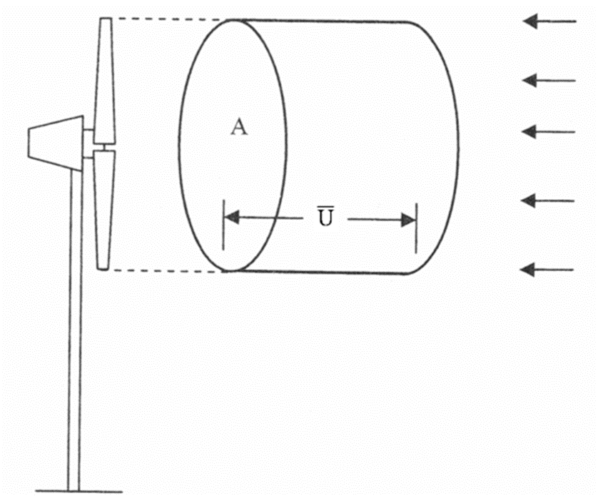
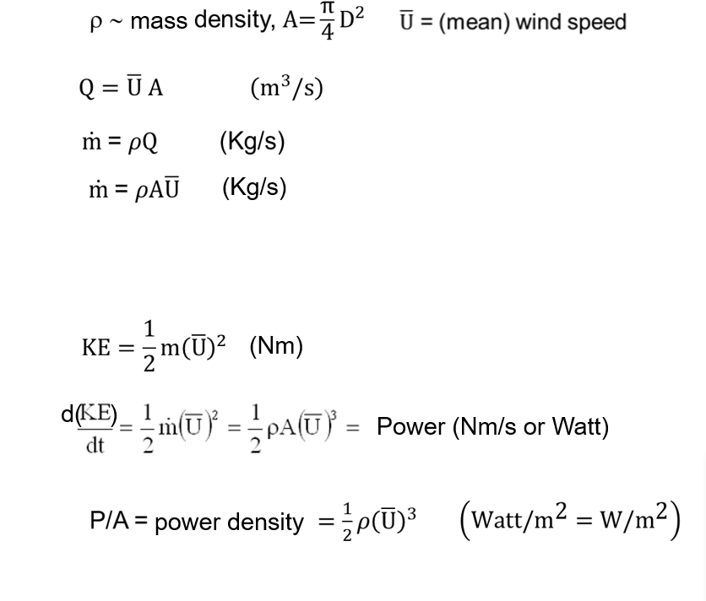
Mathematical Expression Governing Wind Power
U = U (wind velocity)
(details to follow)
U = Assumed uniform, m/s
P = Available Power based on U

Slide 31
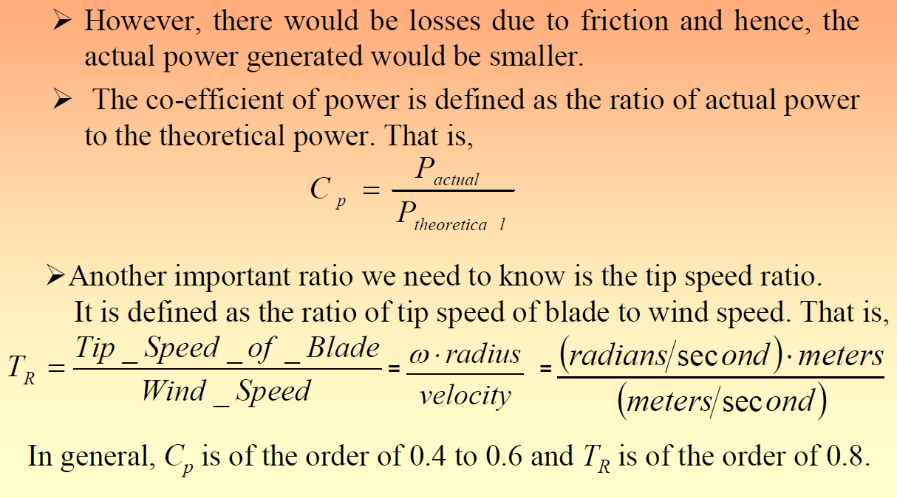
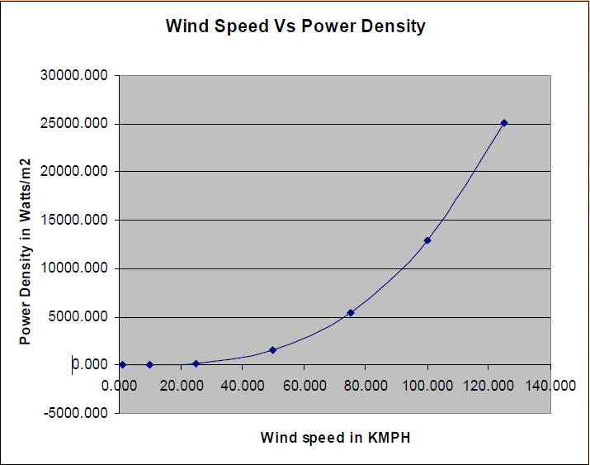
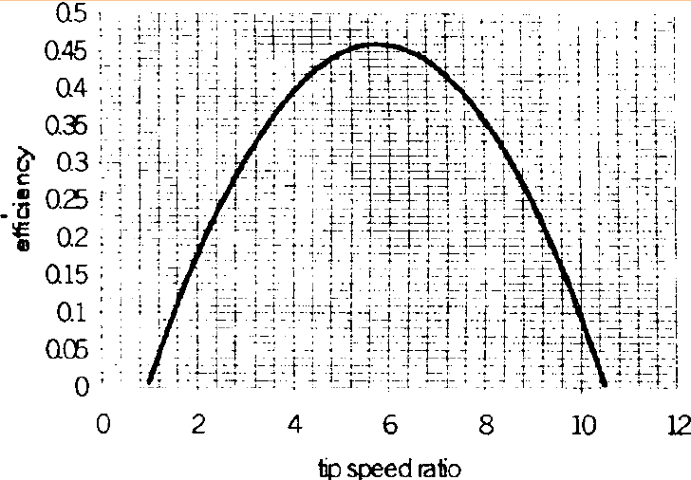
From fig. it is observed that the power coefficient is maximum for a particular tip ratio. So power capture is not optimum at other wind velocity.

Slide 32
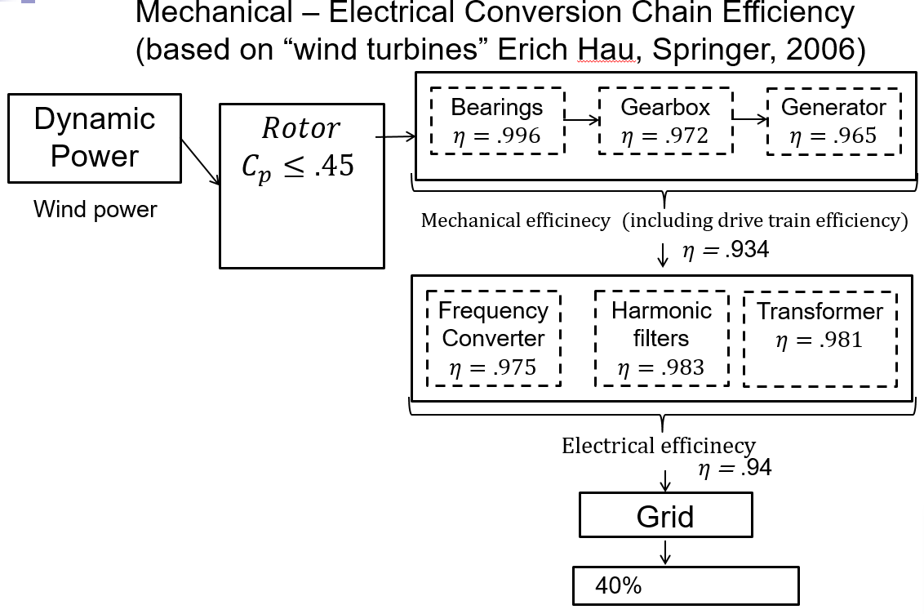

Slide 33
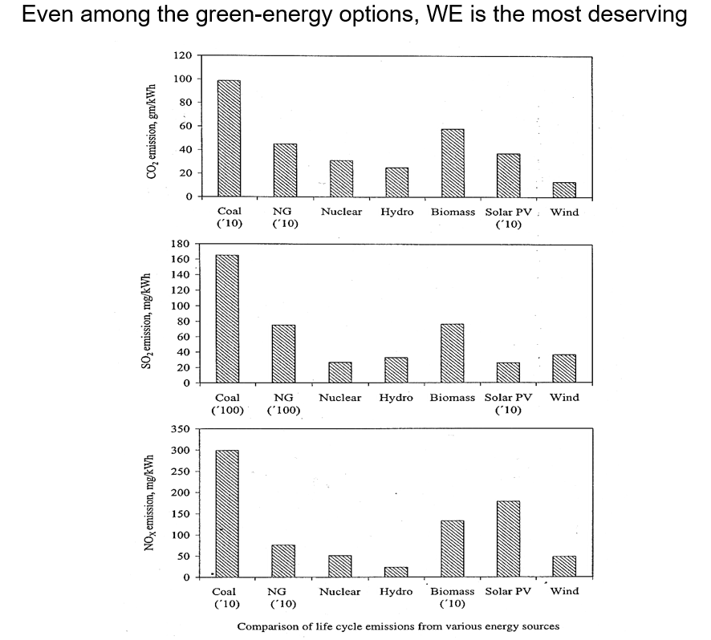
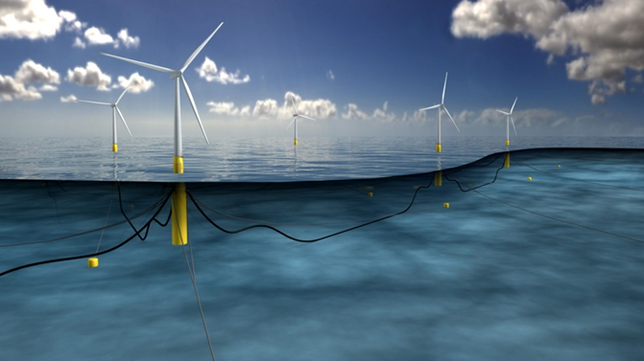
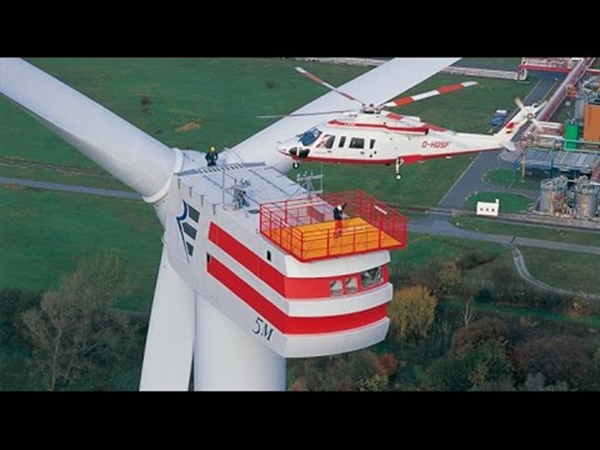
Remarks
By 2035 or 50, wind energy could supply at least 25% – 30% of the U.S. electrical needs, a feat already achieved by Denmark.
A much improved exploitation of offshore sites is a must to achieve this feat.
Wind Farms on land as well as offshore with large wind turbines (diameter ≥ 125 m) offer considerable promise.
For those turbines, the current predictive capabilities for modeling turbulence, wake, turbine-to-turbine interference and dynamic stall merit significant improvements.

